Slide 1

Team Swirling Hurricane
A brief look at how Melbourne recovers after a covid lockdown

Slide 2



The Swirling Hurricane our awesome team
Dillon Wright
Fred Chan
ETL Developer eStore logistics
System accountant and data analytics Absolute care and health
Milinda Liyanage
Business intelligence Manger PFD Foods

Slide 3
Our Presentation
Our Question
Hypothesis
Methodology
First, we look at our initial question
Second, we discuss the hypothesis we came arrived at.
Third, we show how we went about our analysis
Datasets & Cleansing
Charts
Findings
Fourth, we go over the datasets and what we did to cleanse them.
Fifth, we take a deep dive into some of the charts we produced.
Finally, we present our findings

Slide 4


Our Question
Melbourne
We wanted to do an analysis on something highly topical and there is nothing more topical then covid-19 right now. We wanted to determine the impact that covid-19 has on our CBD based businesses especially retail as they have already been doing it tough due to increased competition in the online space.
We also wanted to determine how long it would take for them to recover.
What is the extent of the covid-19 pandemic lockdowns on pedestrian counts within the CBD?
Car Spaces
How did they effect overall car space availability?
Pedestrians
How long will it take for people to return after a lockdown?

Slide 5

Our Hypothesis
Null hypothesis
Hypothesis 1
Hypothesis 2
When the number of covid cases in metropolitan Melbourne increases there is no change in Melbourne CDB foot traffic.
When the number of covid cases in metropolitan Melbourne increases, Melbourne CDB foot traffic & vehicle parking decreases.
When a covid lockdown stage level is lowered the CBD foot traffic increases but with a lag.

Slide 6





Methodology
First, we created a GitHub repo so that we could all work collaboratively as a team in one shared space.
Second, we decided which data sets too look at and acquired them.
Third, we created individual dataset cleansing branches within our GitHub repo.
Fourth, after completing the data cleansing these we merged these into the repos main branch.
Fifth, we merged the data into a summary Frame.
Sixth we did our analysis and created Graphs.
Finally Summarised our findings.
Title Three

Slide 7
Datasets
Covid Cases
Lockdown Dates
We found a data source that gave us Daily Covid numbers for metropolitan Melbourne from the Melbourne CBD council website
We couldn’t find a good data source that suited our needs, so we made one manually by looking at the government DHHS website and Covid-19 Victoria Wikipedia.
Summary
Dataset
Pedestrian Data
Melbourne has at some pedestrian crossings got a pedestrian crossing sensor that collects pedestrian data.
Car Space Occupancy
We found some data on how many car spaces were occupied during the pandemic from the Melbourne CBD council website

Slide 8
Datasets - Cleansing
Covid Cases
Lockdown Date
First we removed overseas and interstate data point.
Second created a list of all metro electorates and used the file the data further to exclude regional Victoria.
Third we aggregated the data to make it Daily / Monthly.
Fourth change the date format of the data to allow for the merge.
Fifth we merged the data into the summary frame
Because there was no dataset that we could find that suited our needs we had to create this dataset manually, and no data cleansing was required because we created the data in the format we needed.
Pedestrian data
Car space data
First we added the data to a database.
Second we queried the database for 4 columns.
Third changed the date format.
Further aggregated the data to Daily.
First we dropped multiple columns 13 in total.
Second changed the date format.
Third dropped the rows which were less then 2 minutes in duration.
Finally merged the data into the summary frame.

Slide 9
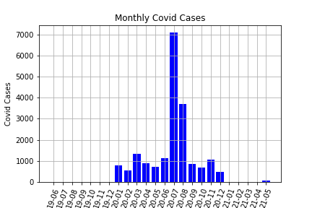
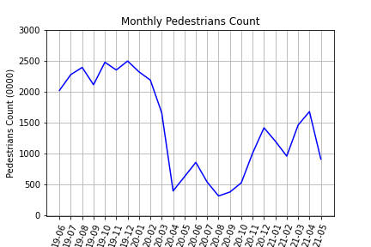
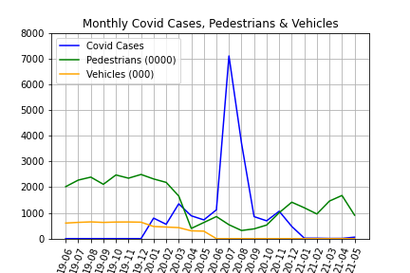
Charts –Three most impactful
Covid Cases
Pedestrian count
Merged data
This chart really gave us a reference point to be able to see the impact of the lockdown dates
This Chart showed us that there was a significant and lasting impact to pedestrians
Here we have the joined the datasets and produced a graph

Slide 10
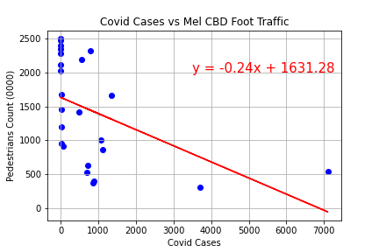

Overall findings
we performed a regression analysis (Fig.1) and the R came at -0.48 which confirms our hypothesis that there is a correlation between Covid cases, and the reduction of pedestrians observed.
Fig.1
Question 1 - What was the impact on pedestrian count
Question 2 – How did the lockdown affect car space availability
There was an 69.3% decrease in pedestrians When comparing Apr to Apr and an increase 83.7% 20 to 21.
There was an 34.1% decrease in Car space availability When comparing Apr to Apr
Question 3 – What was the lag?
We estimated based on fig.2 that the lag would be 3 months before we are back to normal.
Fig.2
Finding 1 - null hypothesis
Finding 2 – Pedestrian traffic will go down
Finding 3 – how long will the lag be
The null hypothesis is proven by the correlation
We have proved this as the R value is strongly negative
We have proved there is a lag and for the most significant lockdown we estimated it would be around 3 months

Slide 11
Thanks!
Any questions?

